Slide 1
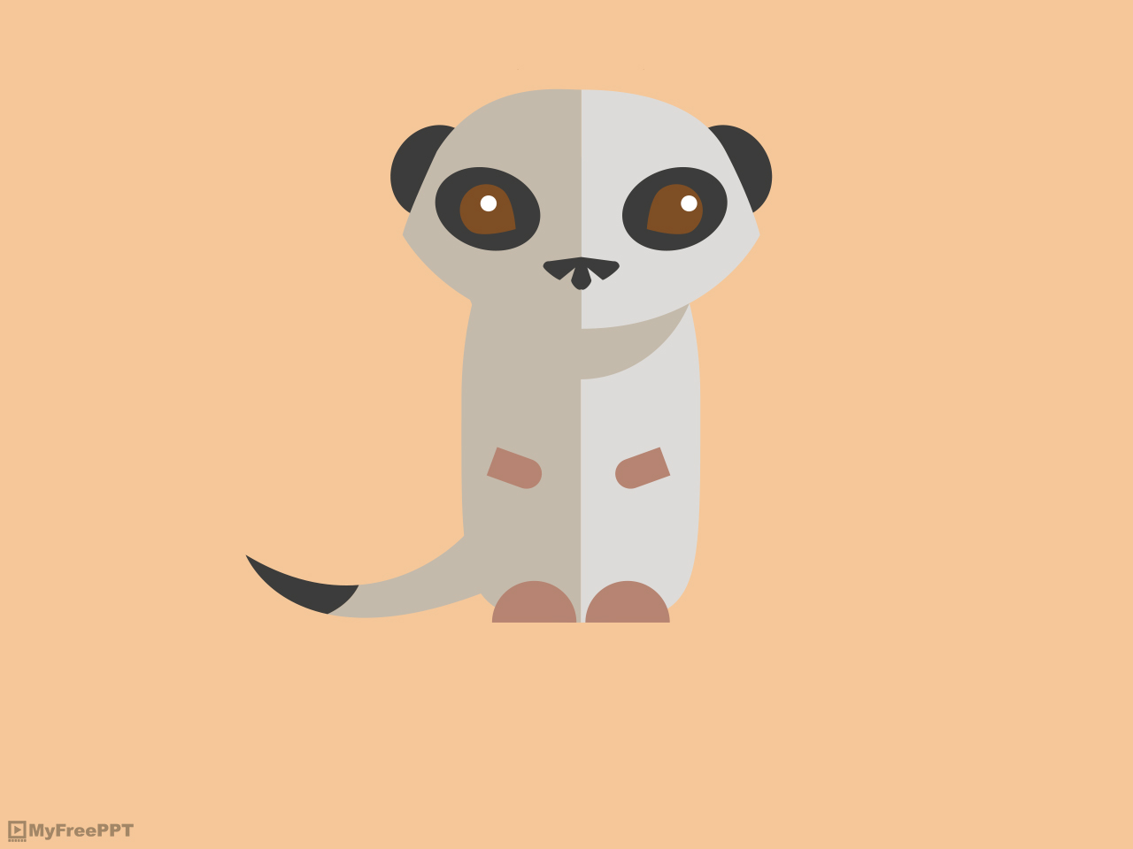
Site “Save together”
Made by JediTeam for competition “Golden byte”

Slide 2
“Save together”
“Save together” is a special project, which main deal is save unique kind of lemurs: the northern sportive lemur. This site is being done for any charity organization, that works with problem of northern sportive lemur `s extinction. This project helps charity organization to work with donation,
because it has administrative part and it also helps people to take part of northern sportive lemur `s rescue by donation.

Slide 3
Project requirements:
This site must allow users to view information about problem of the northern sportive lemur`s survival. Detail information about this kind of lemurs, why they die out and why people have to stop northern sportive lemur`s extinction.
The site must have detail information about regions, where lemurs live now (must be represent like map), about population of lemurs in this regions and also detail information about growth or reduction of lemur`s population.
The site has to provide users the opportunity to choose region, that has problem of the northern sportive lemur`s survival on the map and donate the sum of money.

Slide 4
Project requirements:
This site must allow users to register. During registration process must work validation of input data (for example, client must input first and last name and correct phone number and email). After registration the site send confirmation using email. The site should implement event logging.
This site must allow authorized users to see their own donates (details: sum, region, time).
On the site must be fulfilment mechanism of donates payment. The site has to provide users the opportunity to do anonymous donates.

Slide 5
Project requirements:
On the site must be 3 roles: unauthorized user, authorized user and administrator.
Administrator can monitor the list of donates, the list of users and can see and change detail regions info, where lemurs are living now, population of lemurs and growth or reduction of lemur`s population.
This site must allow users to subscribe or unsubscribe on the news on the site.
This site must allow users to ask questions about lemurs.

Slide 6
Conceptual architecture diagram

Slide 7
Logical architecture diagram

Slide 8
Physical architecture diagram

Slide 9
Role description on the site
 | Unauthorized user | Authorized user | Administrator
view info about lemurs | + | + | +
change info about lemurs |  |  | +
view info about regions | + | + | +
add regions |  |  | +
edit regions |  |  | +
delete regions |  |  | +
register | +
donate | + | +
view list of donates |  | + (only own donates) | +
view list of users |  |  | +
view information about user |  | + (only own info) | +
edit information about user |  | + (only own info) | +
ask questions | + | +
view list of questions |  | + (only own questions) | +
answer questions |  |  | +
subscribe | + | +
unsubscribe | + | +

Slide 10
Class diagram

Slide 11
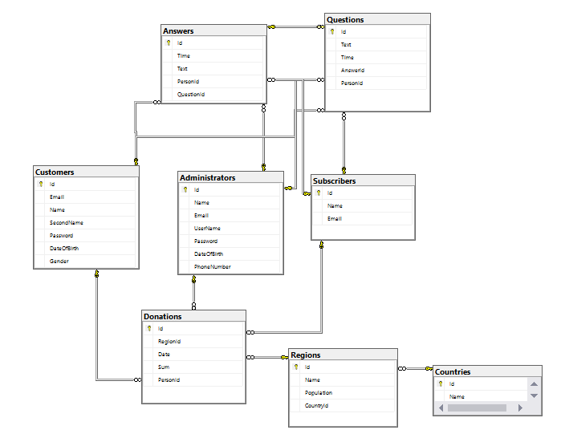
Database schema

Slide 12









Stack of technologies
Data layer
Business layer
Presentation layer

Slide 13
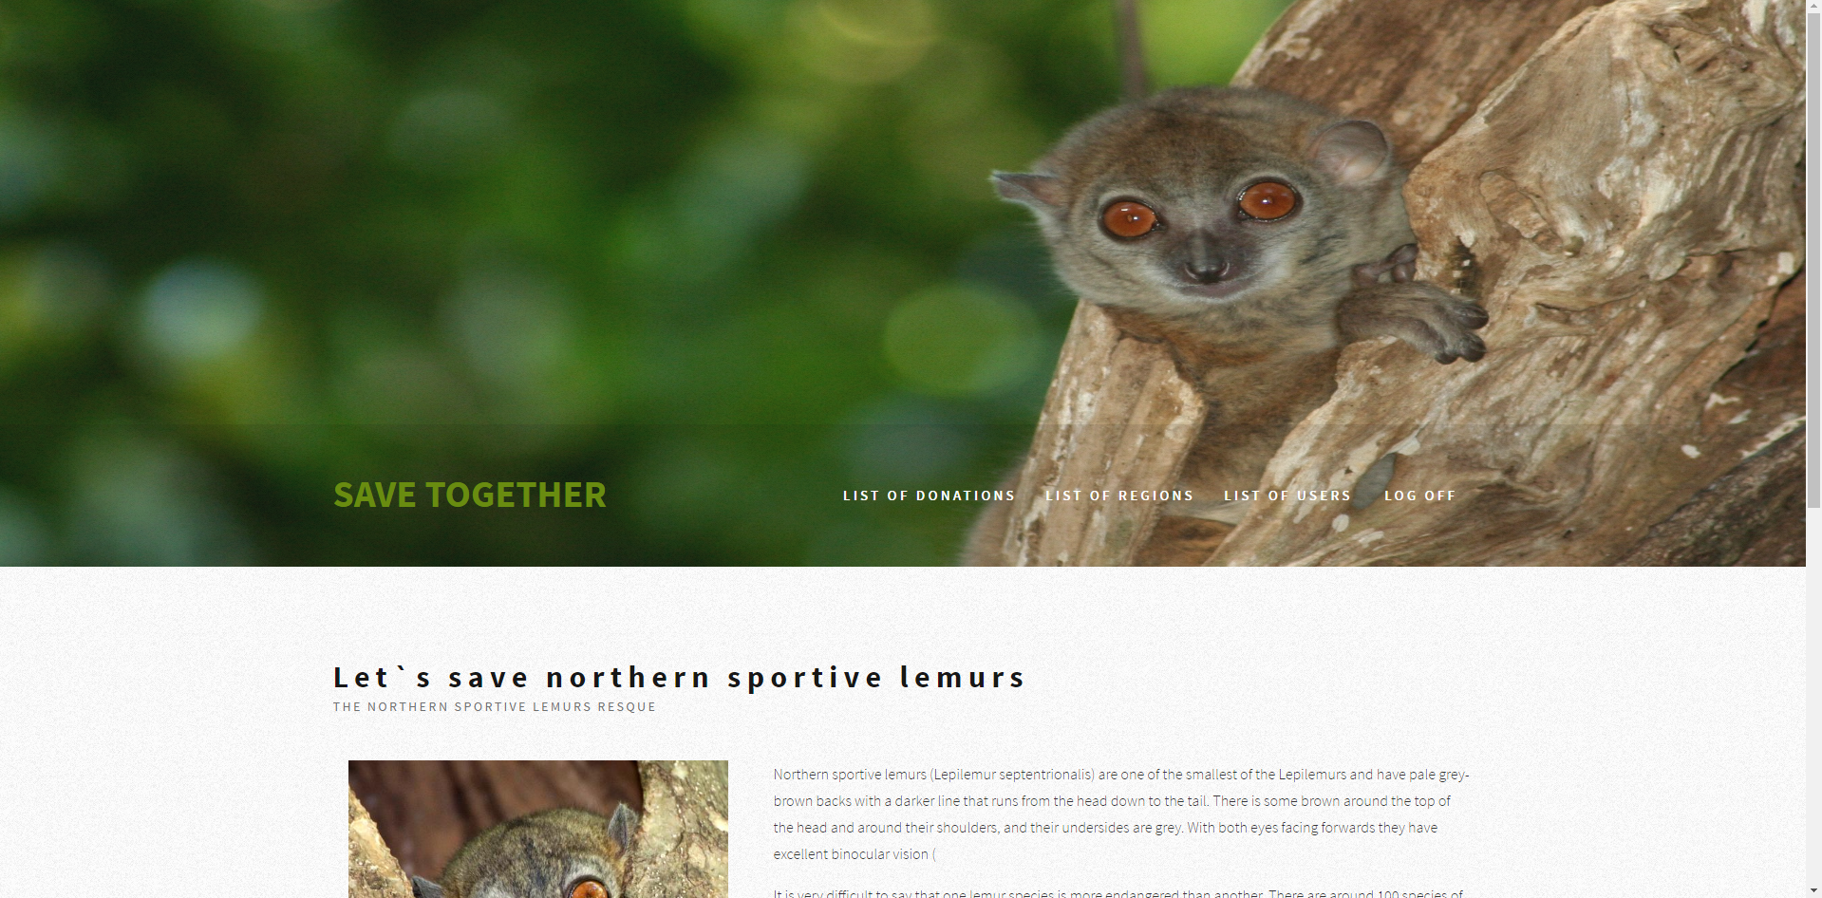
Main page

Slide 14
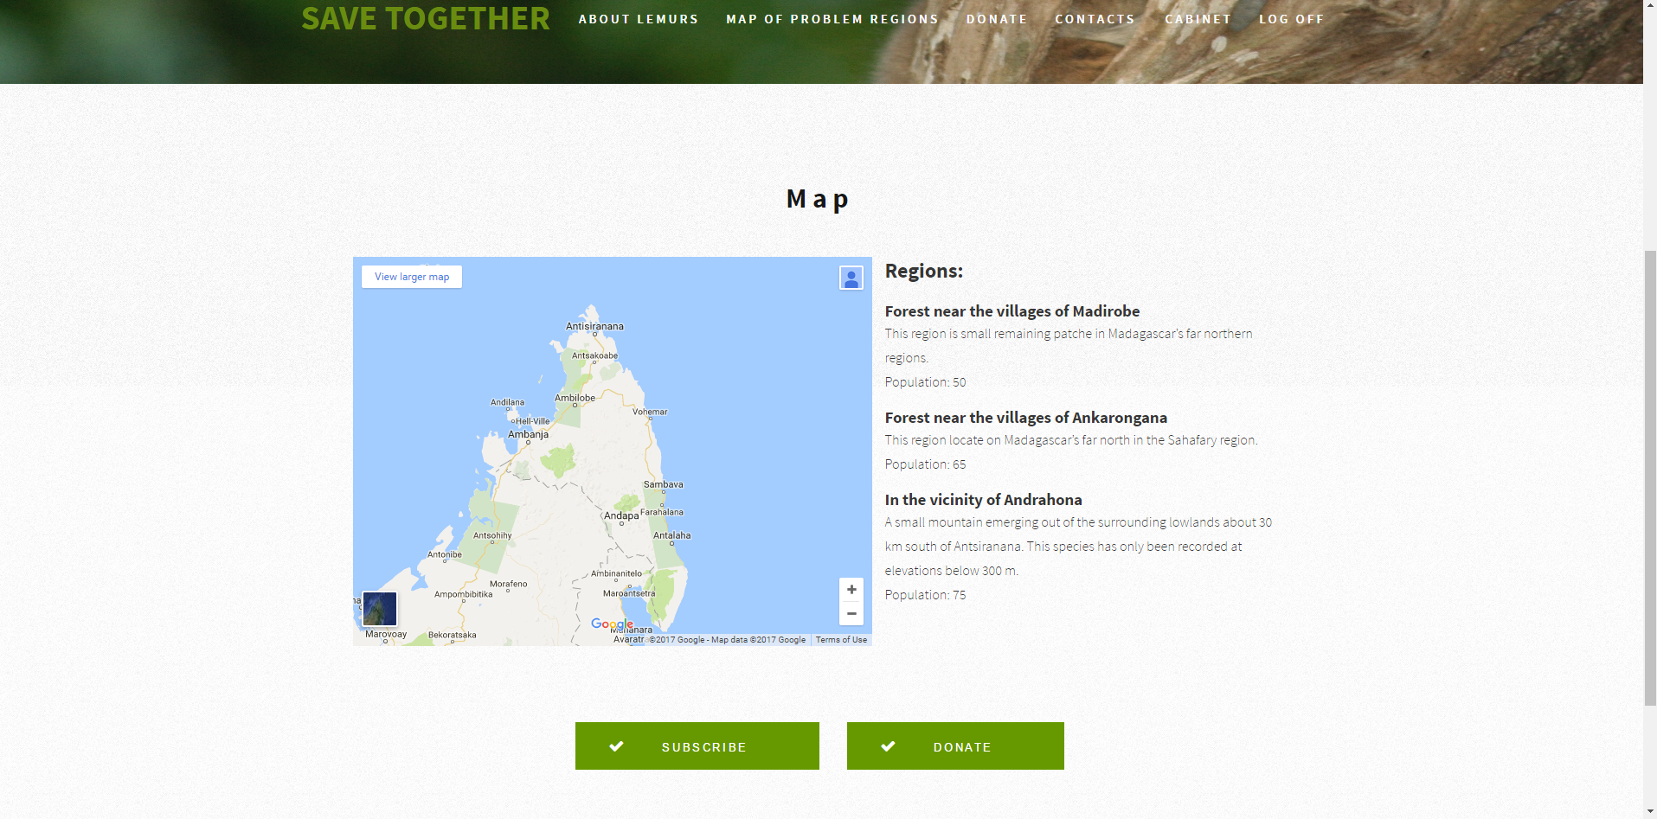
Region`s choose page

Slide 15
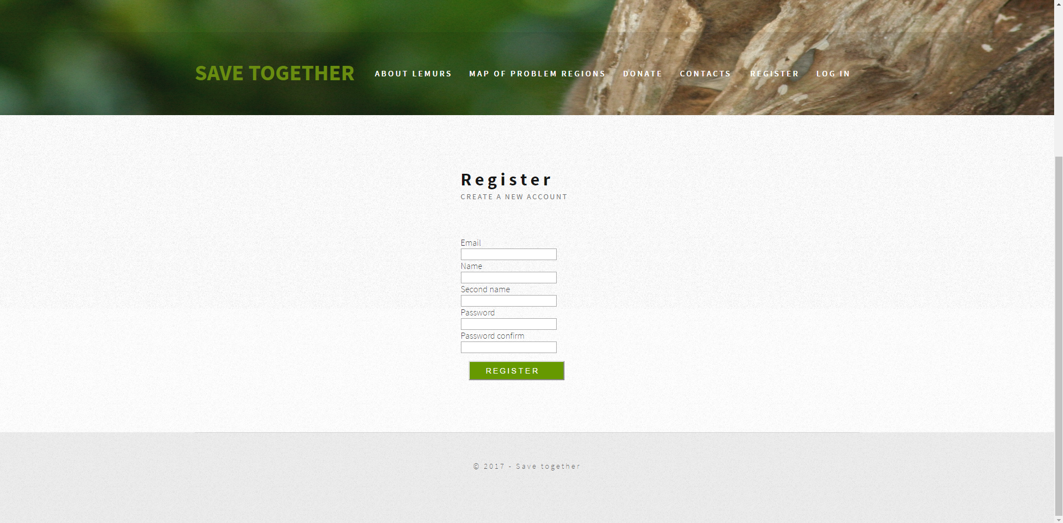
Registration page

Slide 16
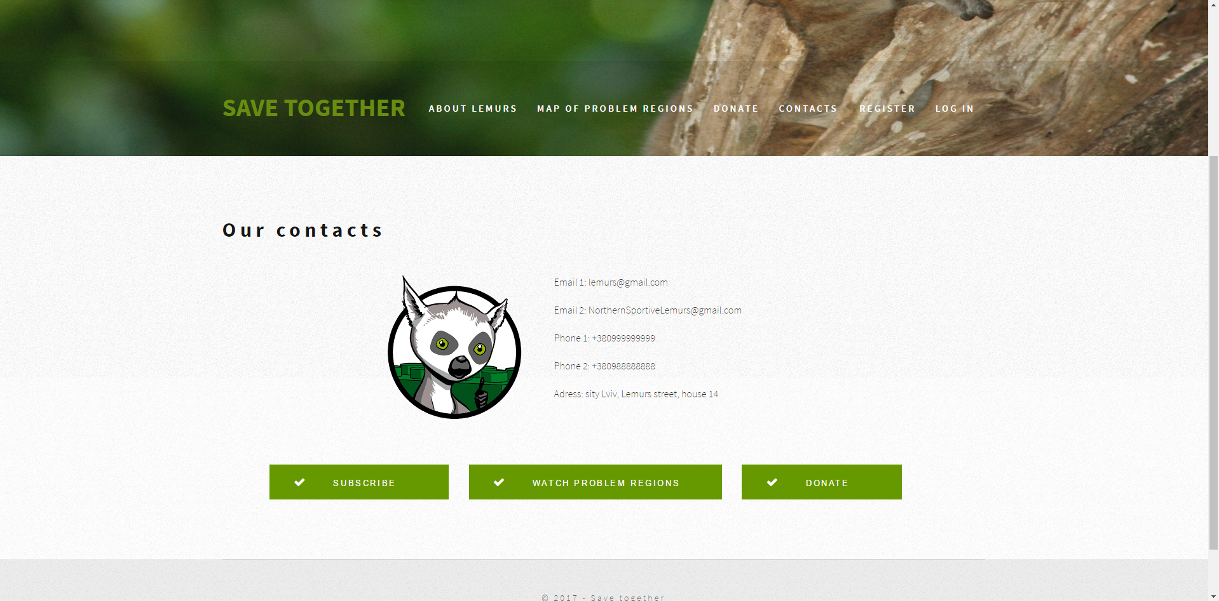
Contact page

Slide 17
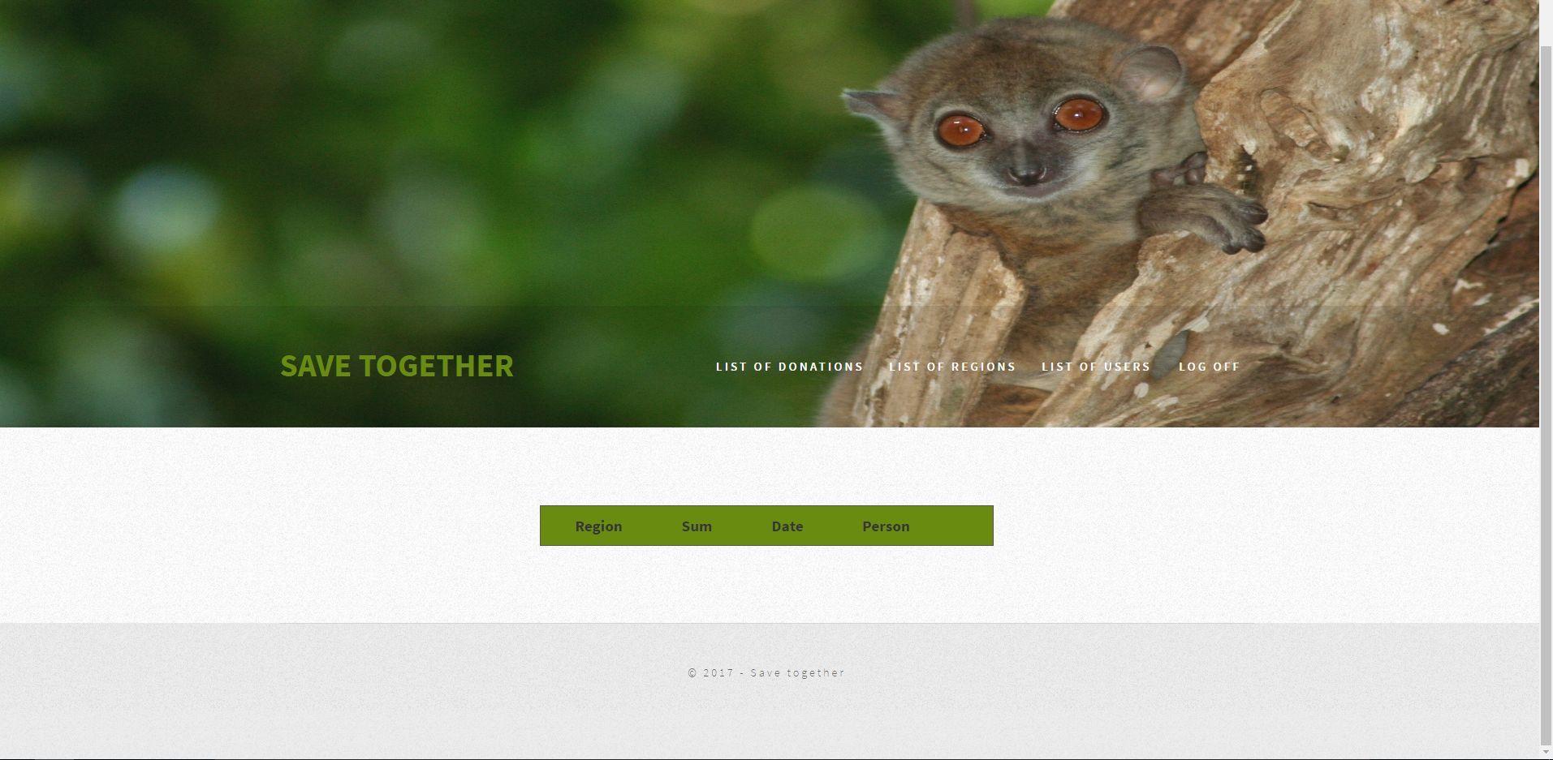
Donation list page

Slide 18
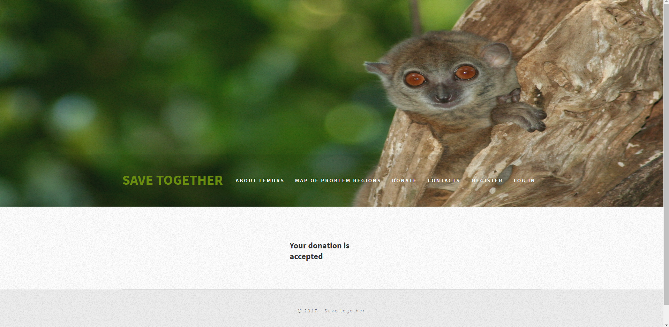
Successful donation

Slide 19
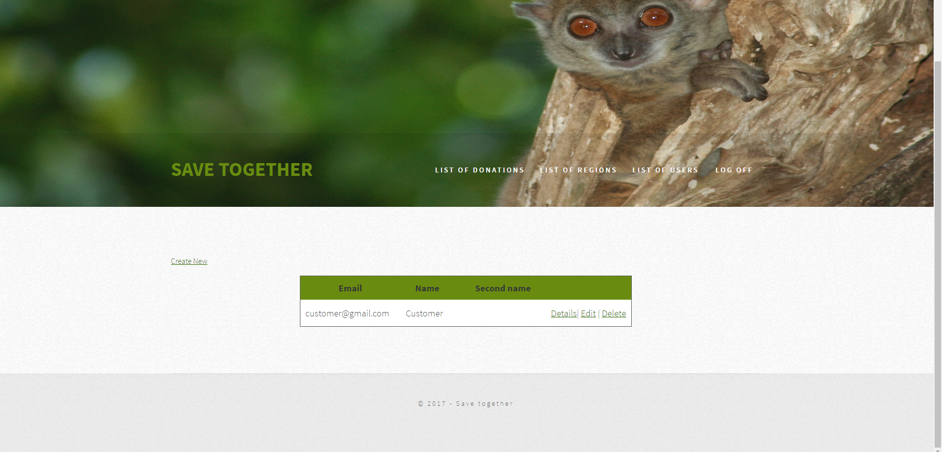
User list page

Slide 20
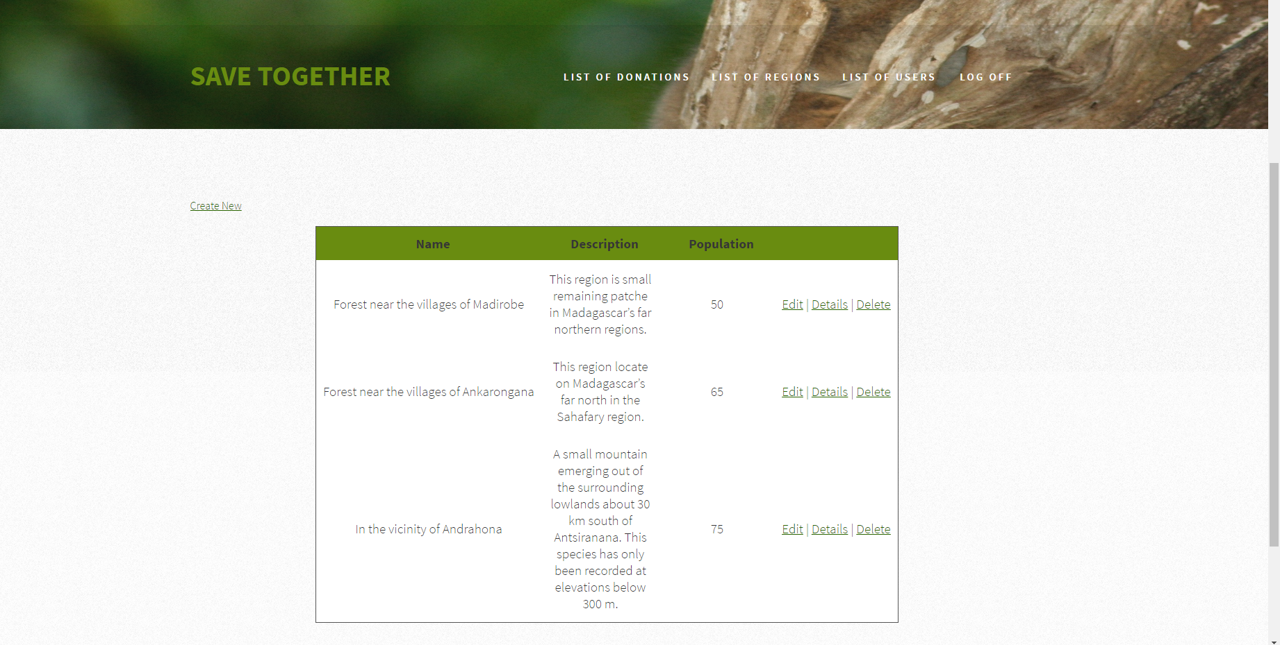
Region list page

Slide 21
Contacts:
Team: JediTeam
Team member:
Tatiana Zhydeikina
mob.: +380960152650
email: zhidejkina@gmail.com

